Slide 1
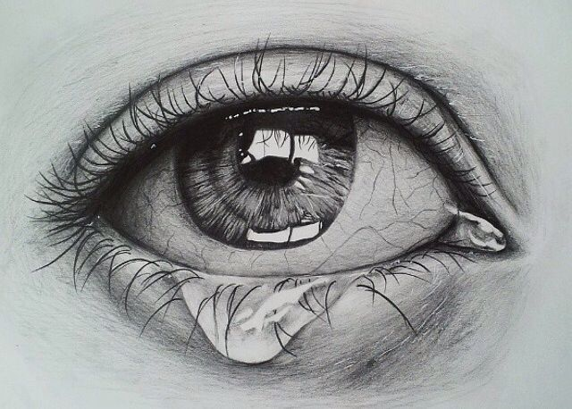


16 DAYS
IS NOT
ENOUGH
DON’T LOOK AWAY!
ACT TO END GENDER BASED VIOLENCE NOW!

Slide 2


NO MORE CHANCES

Slide 3


SILENCE ALLOWS VIOLENCE

Slide 4






Break the silence.
Stop the shame.
Shift the blame.

